Slide 1


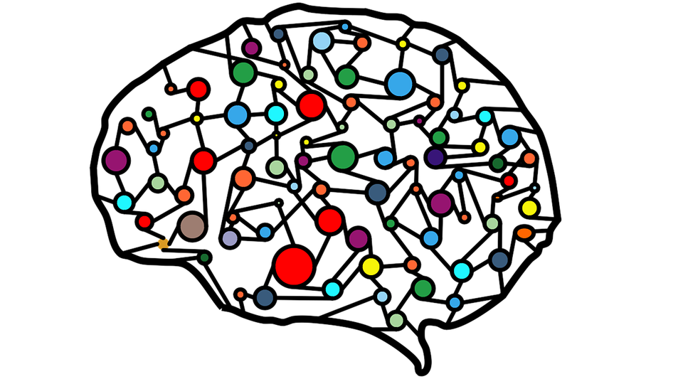
Tweet’s Gathered
Tweet Comparison Presented
User selects a preference
Tweet’s Ranking updated
ML & NLP Analysis
vs
Winner

Slide 2
Index
Feedback
Comparison
What is Comparative Judgement
Results

